Slide 1
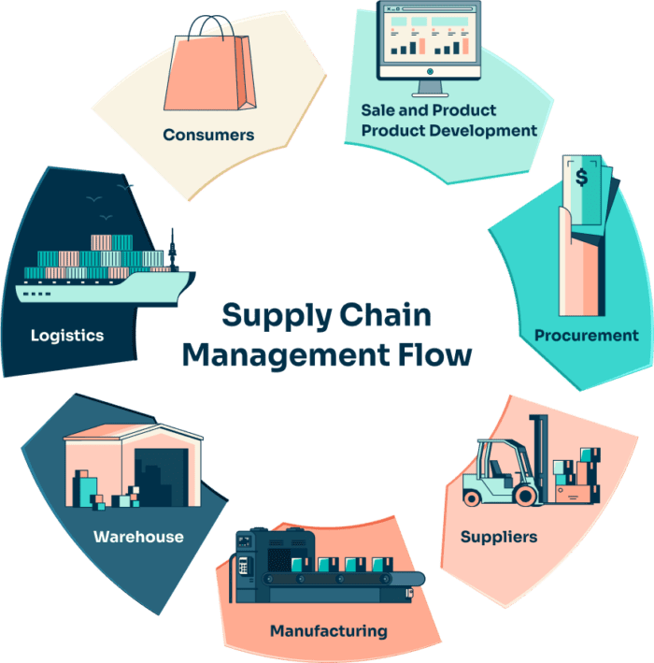
CAPSTONE PROJECT A Study on Optimizing Warehouse Allocation for Cost Efficiency in Multi-Echelon Supply Chain
FEBIN FRANCIS

Slide 2
INTRODUCTION
Warehouse allocation plays a pivotal role in multi-echelon supply chain, where inventory must be efficiently distributed across different levels, including manufacturers, distribution centers, and retail locations. Poor allocation strategies result in high inventory holding costs, inefficient space utilization, increased transportation expenses, and stock imbalances. As supply chains become more complex due to globalization, fluctuating demand, and supply chain disruptions, businesses seek advanced optimization techniques to enhance efficiency and minimize costs.

Slide 3
PROBLEM STATEMENT
In multi-echelon supply chains, inefficient warehouse allocation leads to high operational costs, suboptimal inventory distribution and higher transportation costs. Businesses face challenges in minimizing warehouse costs. Traditional allocation methods often fail to adapt to dynamic supply chain complexities. So this study aims to address these challenges by leveraging advanced optimization algorithms rather than relaying on traditional approaches.

Slide 4
OBJECTIVE
To analyze warehouse and logistics in multi-echelon supply chains and identify key factors influencing warehouse allocation and cost efficiency.
To evaluate different warehouse allocation strategies by applying advanced optimization techniques
To determine the most effective optimization approach for minimizing warehouse costs by evaluating cost reductions

Slide 5
DATA DICTIONARY
1. WhCapacities
2. WhCosts
3. ProductsPerPlant
Source : Brunel University London
https://brunel.figshare.com/articles/dataset/Supply_Chain_Logistics_Problem_Dataset/7558679?file=20162015
Field Name | Data Type | Description
Plant ID | Text | Unique identifier for the plant.
Daily Capacity | Integer | The daily production or storage capacity of the plant.
Field Name | Data Type | Description
WH | Text | Warehouse or plant identifier.
Cost/unit | Float | The cost per unit for storage or production at the warehouse/plant.
Field Name | Data Type | Description
Plant Code | Text | Unique identifier for the plant.
Product ID | Integer | Unique identifier for the product produced at the plant.

Slide 6
DATA DICTIONARY (Cont.)
4. PlantPorts
5. FreightRates
Field Name | Data Type | Description
Plant Code | Text | Unique identifier for the plant.
Port | Text | The associated port for the plant.
Field Name | Data Type | Description
Carrier | Text | Name or identifier of the logistics carrier.
orig_port_cd | Text | Code for the origin port.
dest_port_cd | Text | Code for the destination port.
minm_wgh_qty | Float | Minimum weight quantity allowed for shipping.
max_wgh_qty | Float | Maximum weight quantity allowed for shipping.
minimum cost | Float | Minimum cost associated with the freight.
rate | Float | Rate charged per unit of weight.
mode_dsc | Text | Description of the transportation mode (e.g., Air, Sea, Road).
tpt_day_cnt | Integer | Number of days required for transportation.
Carrier type | Text | Type of carrier used for transportation.

Slide 7
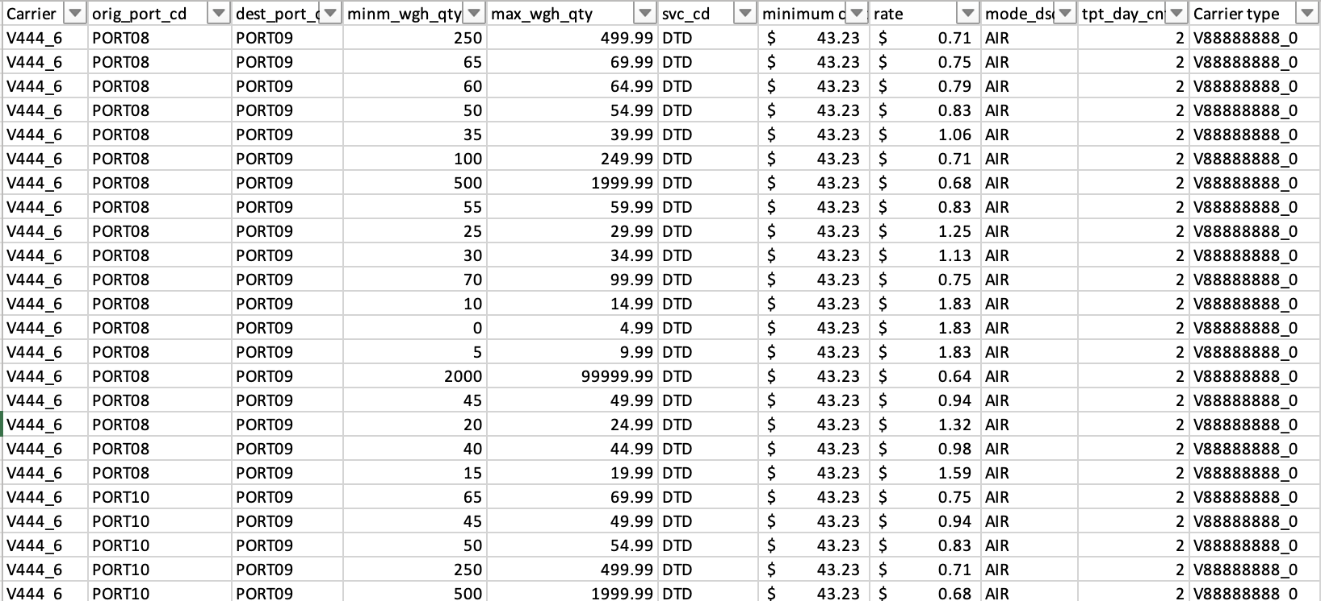
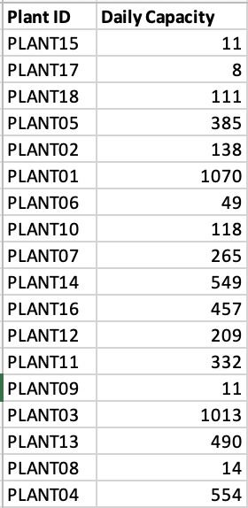
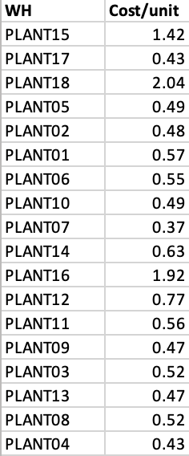
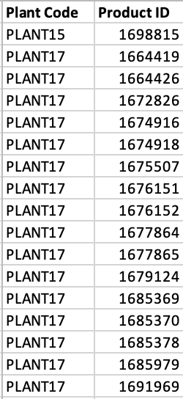
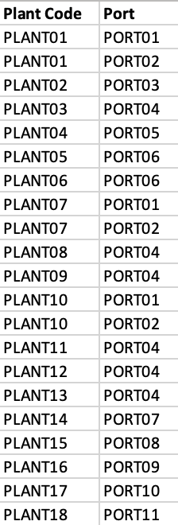
DATA SCREENSHOT

Slide 8
TOOLS AND TECHNIQUES
Tools
Google Colab
Python
Libraries - Pandas, NumPy, Matplotlib, Seaborn, DEAP, swarm-intelligence, Mealpy
Techniques
Genetic Algorithm
Ant Colony Optimization
Dung Beetle Optimization

Slide 9
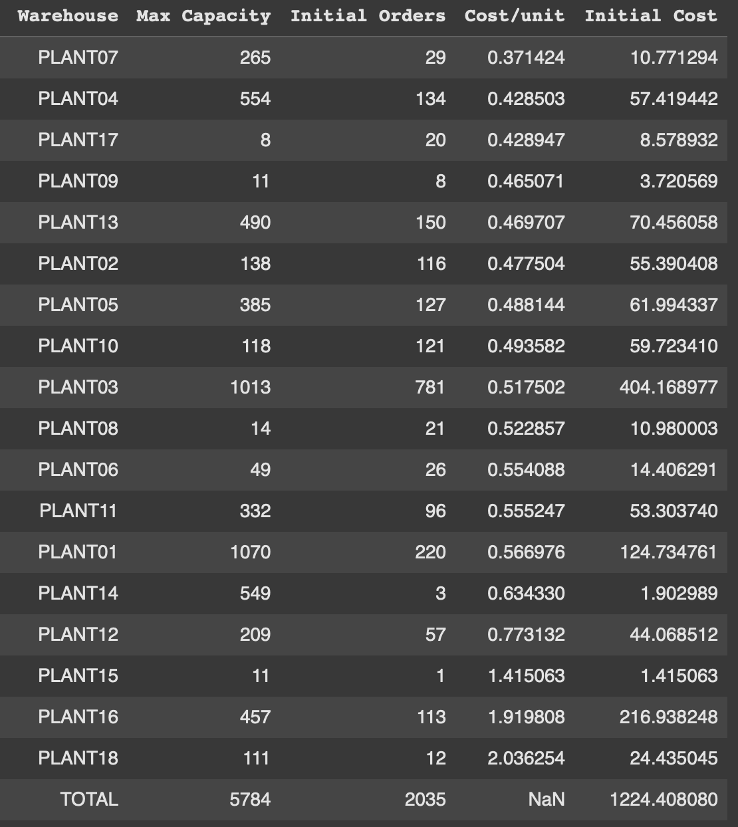
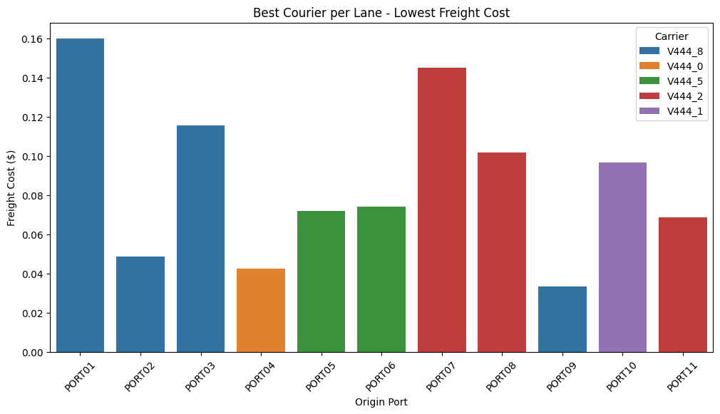
ANALYSIS
1. Exploratory Data Analysis

Slide 10
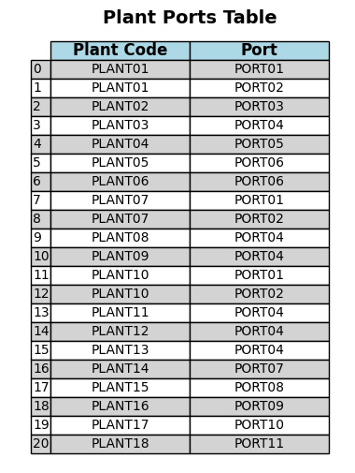
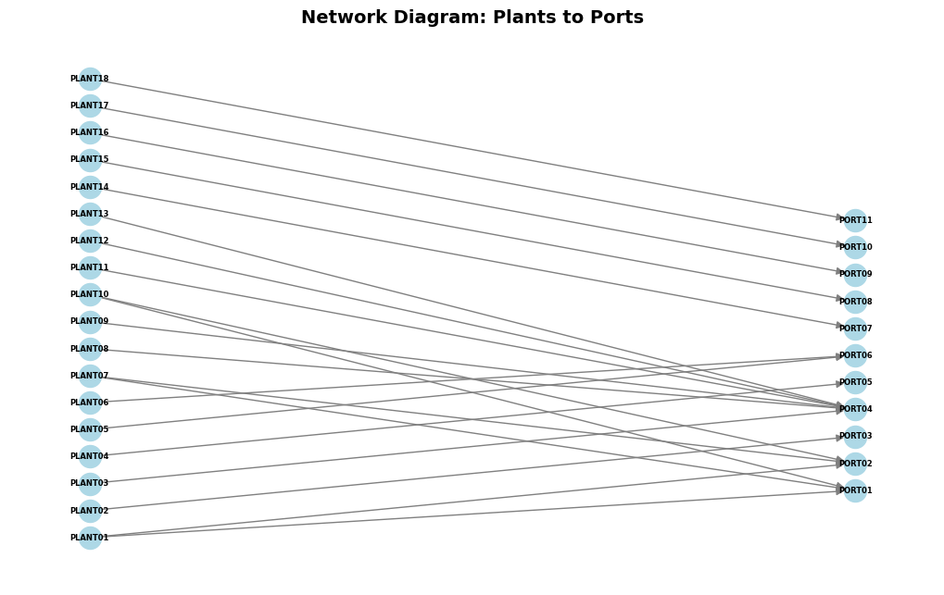
1. Exploratory Data Analysis

Slide 11
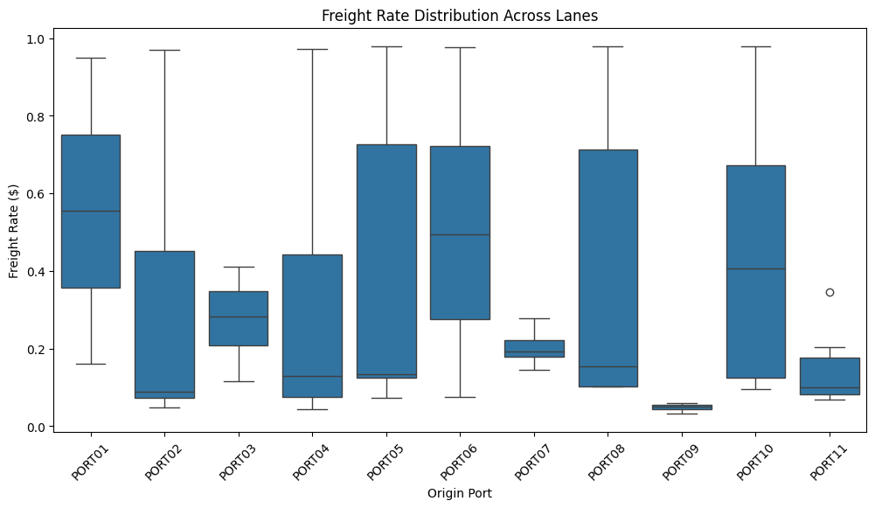
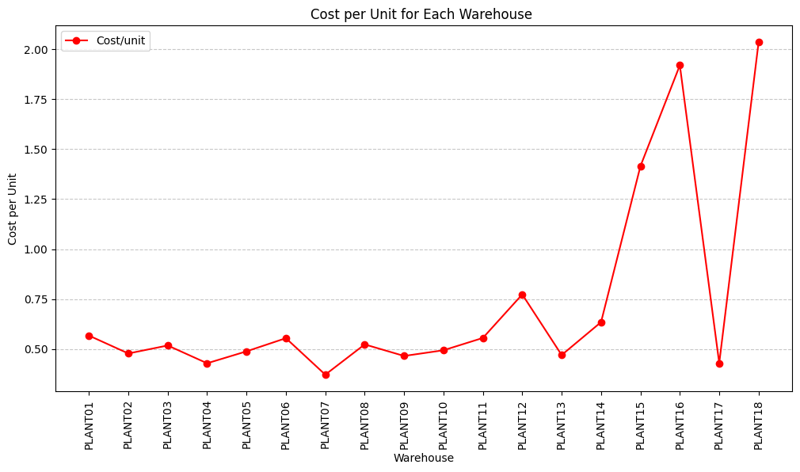
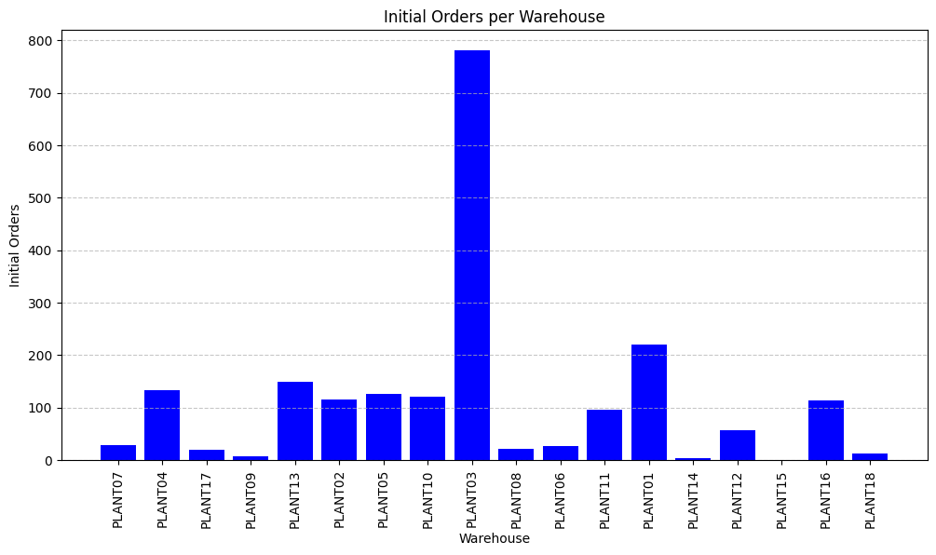
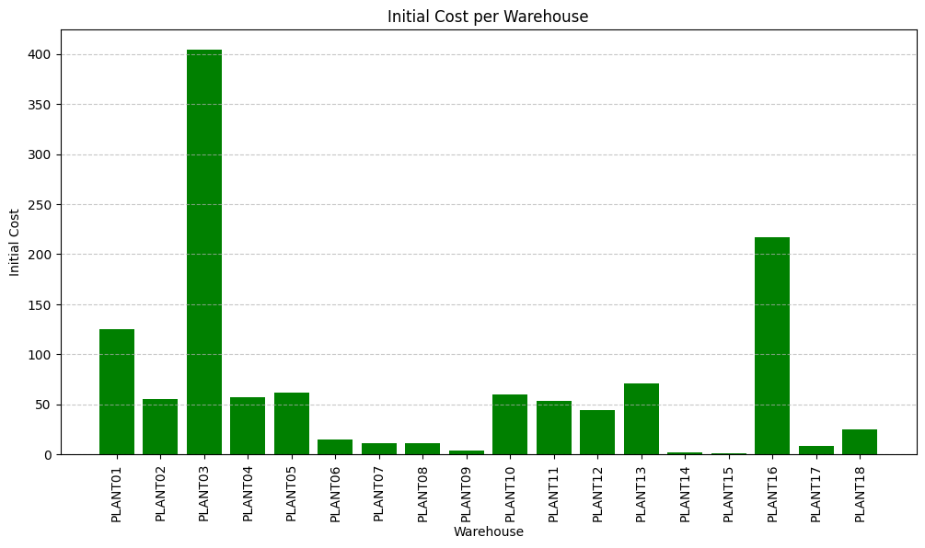
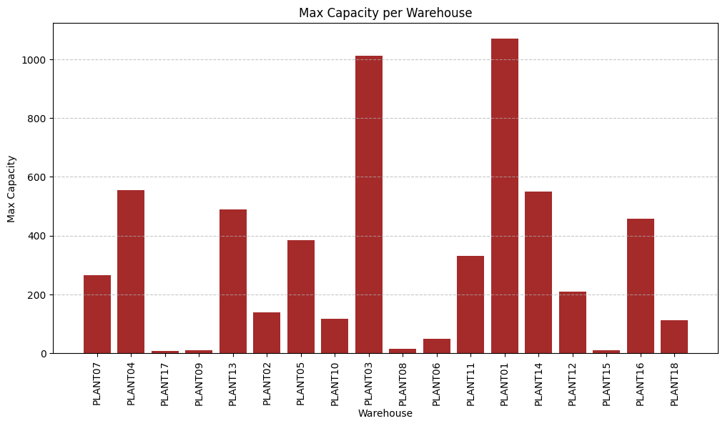
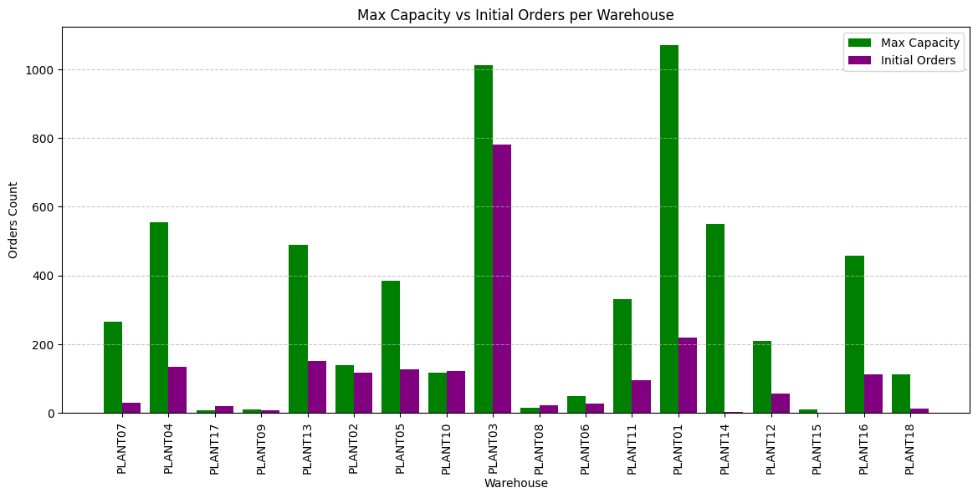
1. Exploratory Data Analysis

Slide 12
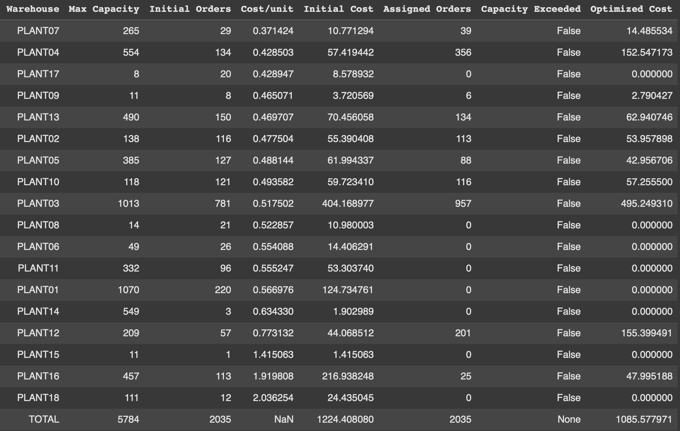

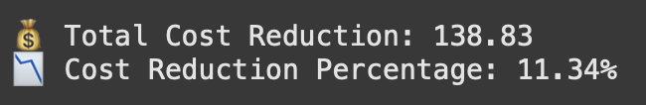
2. Genetic Algorithm

Slide 13
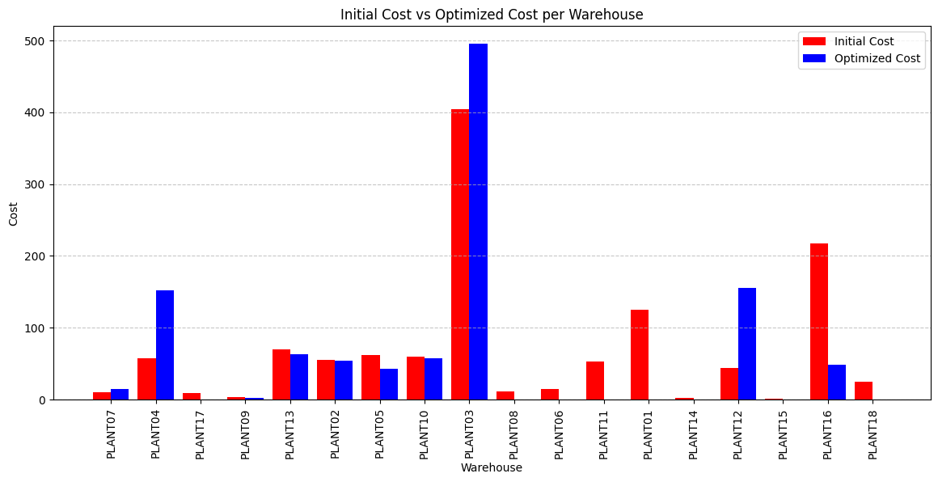
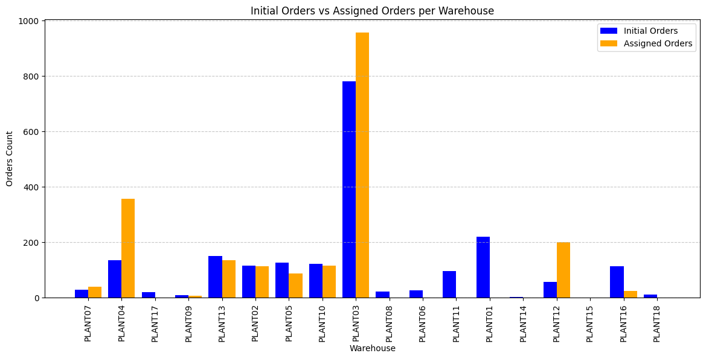
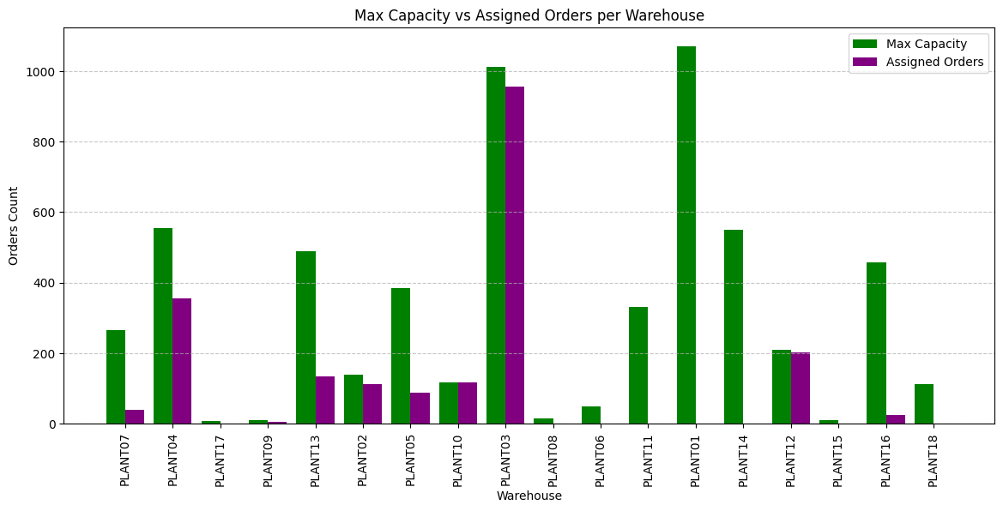
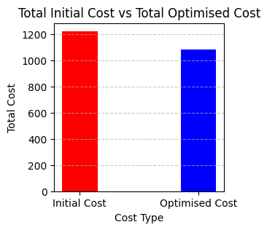
2. Genetic Algorithm

Slide 14
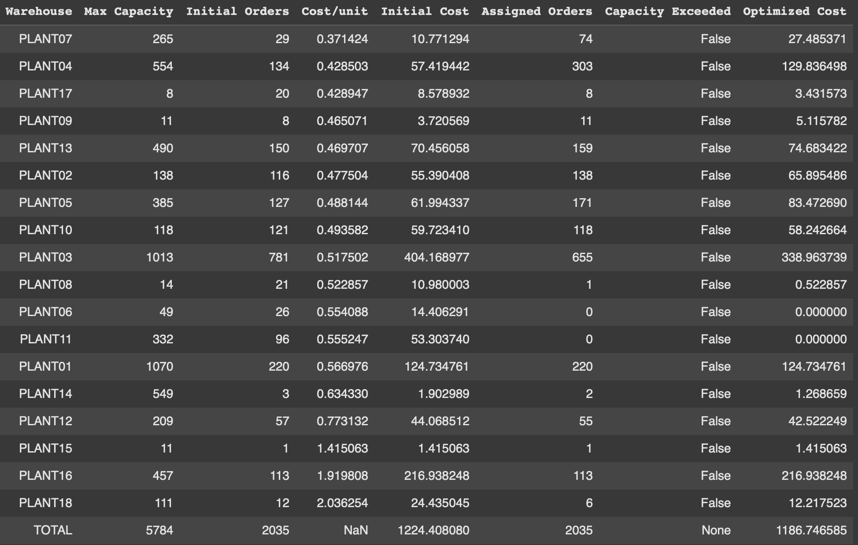

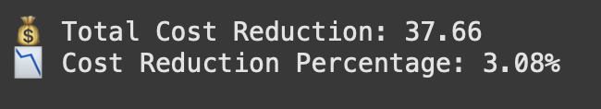
3. Ant Colony Optimization

Slide 15
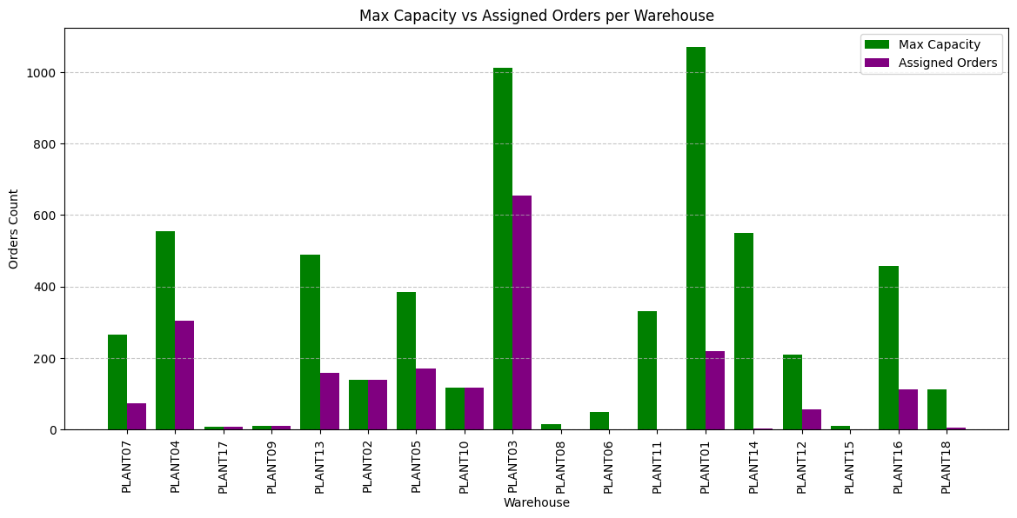
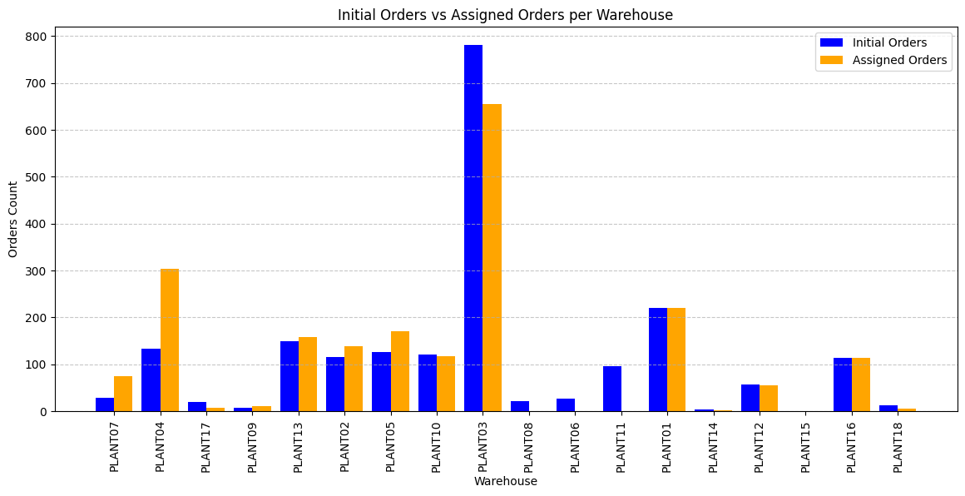
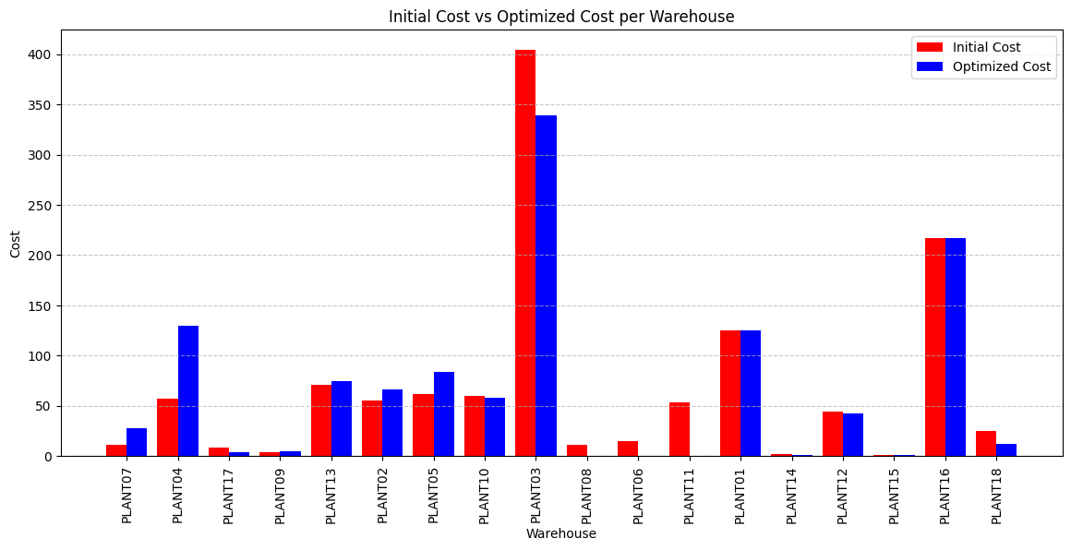
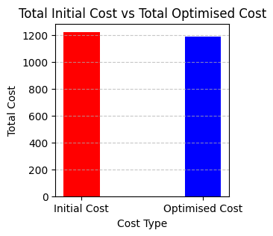
3. Ant Colony Optimization

Slide 16
4. Dung Beetle Optimization

Slide 17
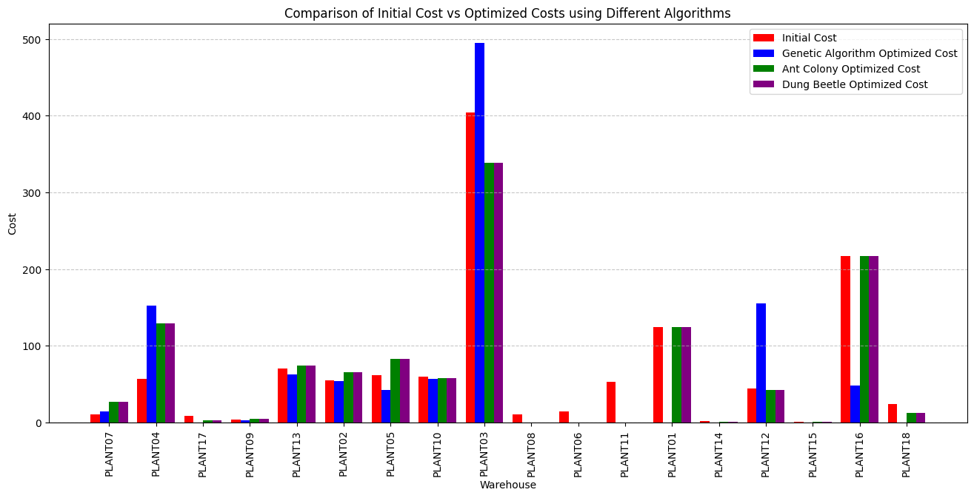
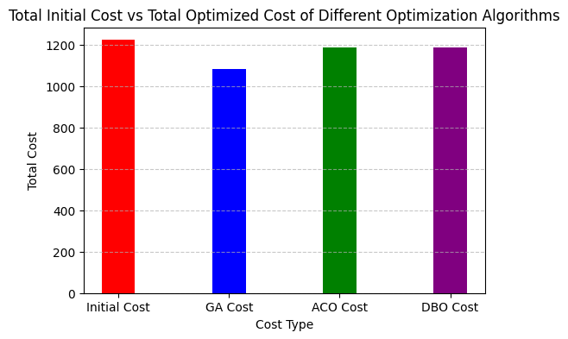
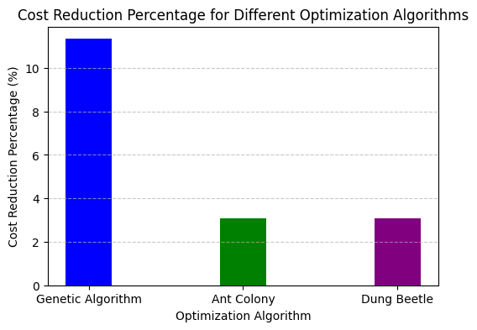
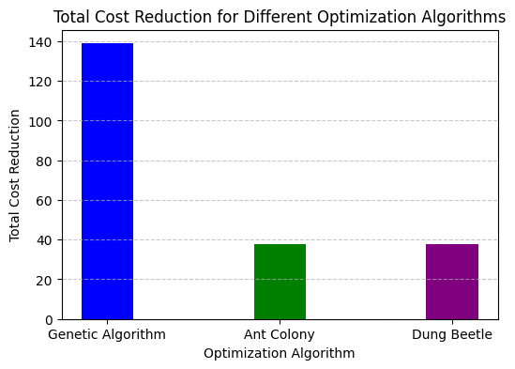
5. Overall Cost Analysis

Slide 18
FINDINGS
1. Cost Optimization:
GA achieved the highest cost reduction of 11.34% (~140 USD), making it the best option for businesses looking to optimize warehouse allocation.
ACO and DBO resulted in only a 3.08% reduction (~37 140 USD), indicating lower cost-effectiveness compared to GA.
GA’s superior cost-cutting capabilities directly improve profit margins and operational efficiency.
2. Warehouse Utilization:
GA have 8 unallocated warehouses of 8 demonstrating efficient inventory distribution based on cost.
ACO and DBO a resulted in 2 unallocated warehouses but were less effective in cost savings.
This suggests that GA is the most balanced algorithm, ensuring both cost efficiency and effective warehouse usage.

Slide 19
FINDINGS
3. Operational Stability:
ACO and DBO provided more stable allocations but failed to maximize cost savings.
These algorithms may be better suited for risk-averse supply chain strategies where stability and predictability are prioritized over aggressive cost-cutting.
4. Optimization of Warehouse based on cost
The cost per unit varies across different plants, with Plant07 having the lowest cost per unit at $0.37 and Plant18 the highest at $2.03
The genetic algorithm (GA) yielded the best optimization results, reducing costs significantly across plants compared to Ant Colony Optimization (ACO) and Dung Beetle Optimization (DBO).
ACO and DBO both achieved an identical cost reduction of 3.08%, while GA achieved a much higher cost reduction of 11.34%, making it the most effective optimization approach for this dataset.

Slide 20
FINDINGS
5. Plant-to-Port Connectivity and Freight Cost Analysis
The analysis of port connectivity revealed that Port09, Port04, and Port02 offer the lowest freight costs. These ports should be prioritized for future shipping routes to minimize logistics expenses.
Plants with direct connectivity to these lower-cost ports should have a cost advantage in supply chain operations.
6. Comparison of Optimization Algorithms
Genetic Algorithm (GA) outperformed both ACO and DBO, demonstrating a higher total cost reduction of 138.83 USD (11.34%), compared to the 3.08% reduction achieved by ACO and DBO.
In terms of warehouse allocation and order distribution, GA allocated resources more efficiently, minimizing overall logistics costs.

Slide 21
CONCLUSION AND RECOMMENDATIONS
Genetic Algorithm (GA) is the most effective optimization technique for warehouse allocation, as it reduces costs significantly while maintaining efficient inventory distribution.
ACO and DBO provide stability in warehouse allocation, ensuring capacity constraints are not exceeded, but their cost savings are suboptimal compared to GA.
Businesses seeking aggressive cost reductions should adopt GA, while companies prioritizing stable, predictable allocations may consider ACO or DBO.

